Slide 1


Slide 2


Slide 3
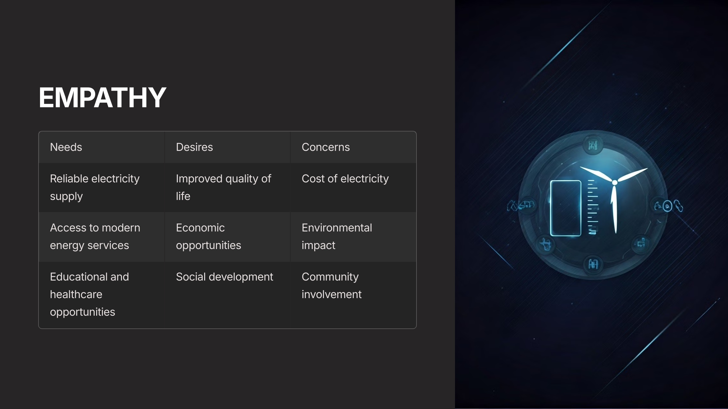

Slide 4
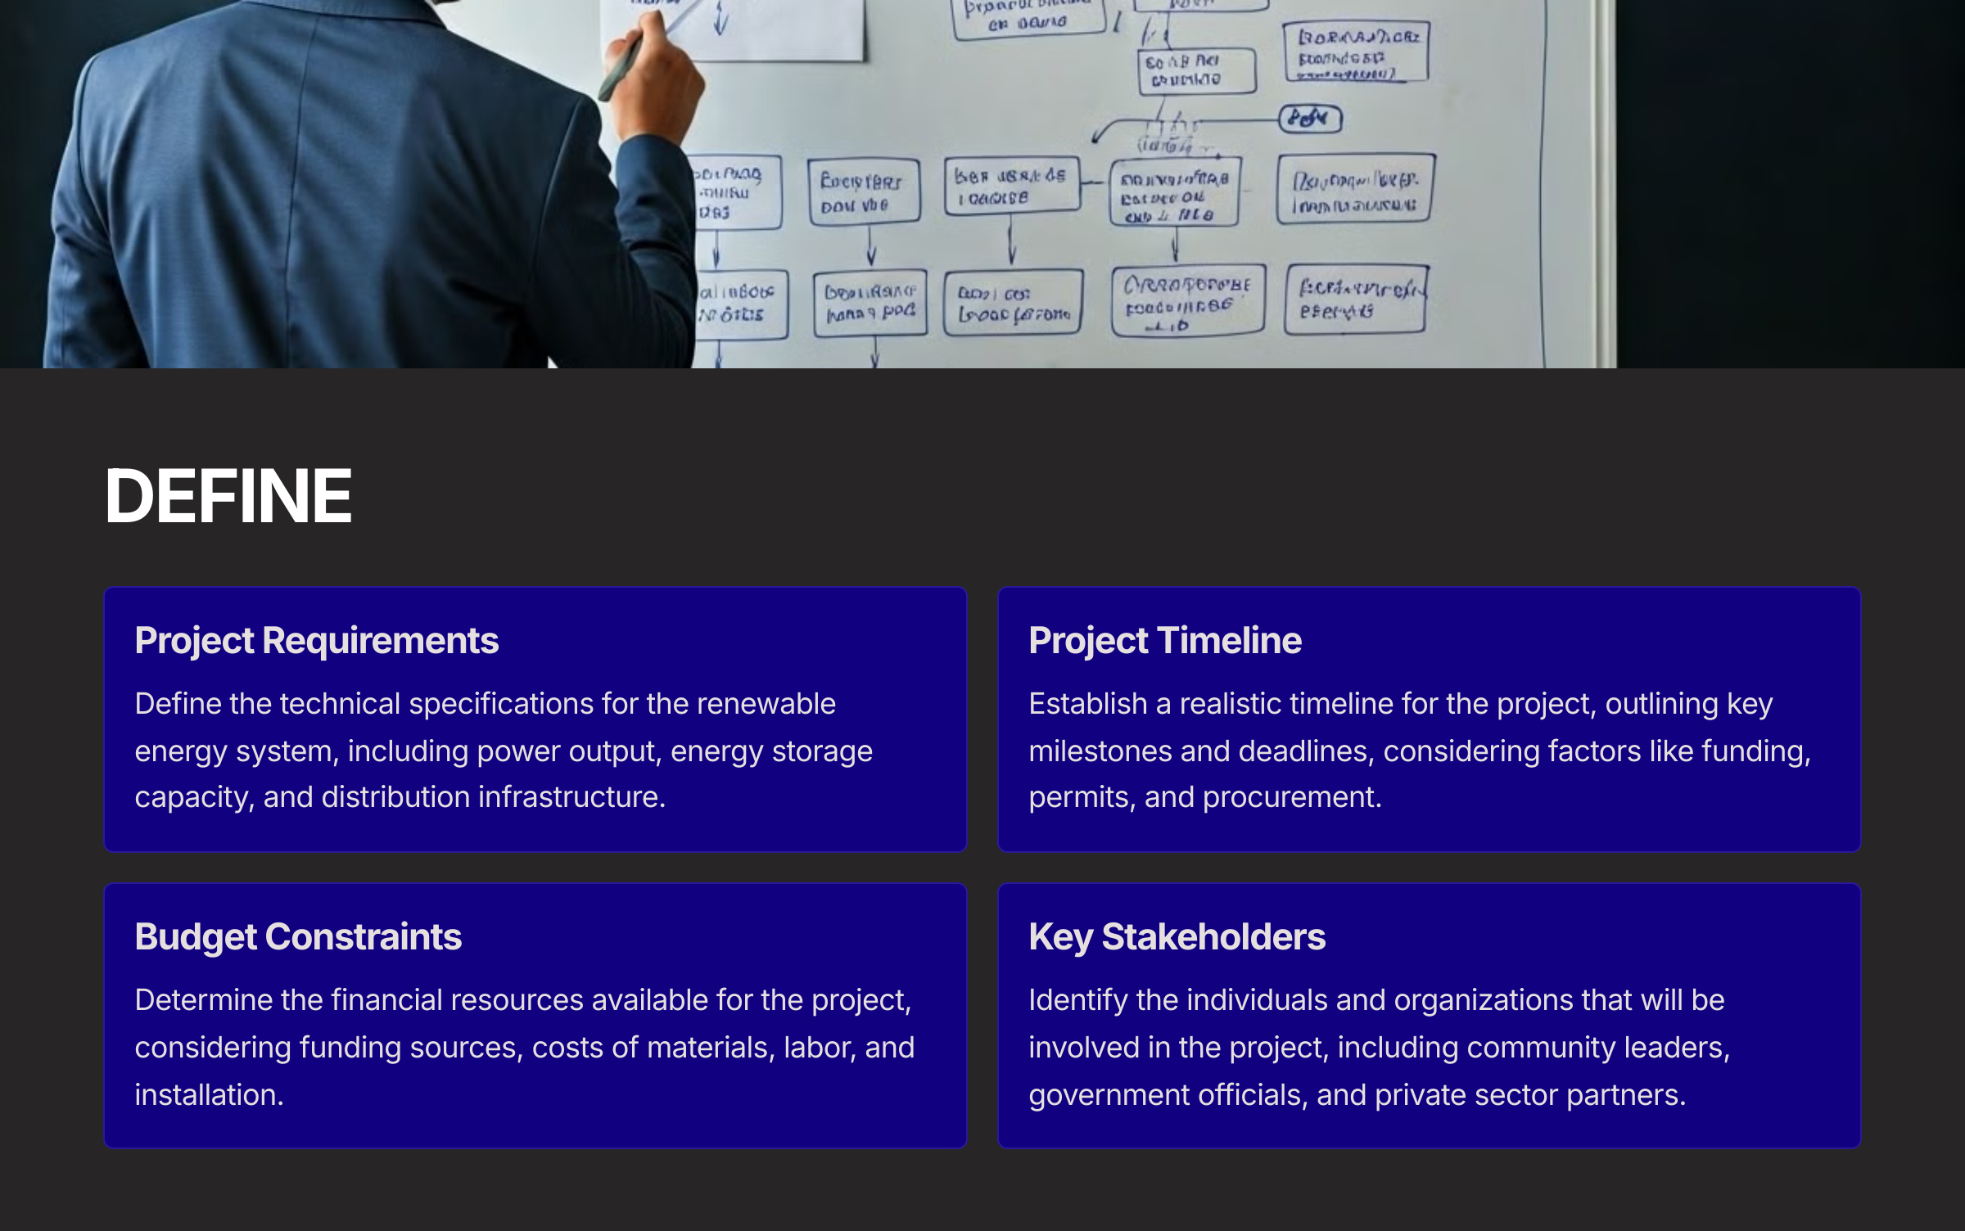

Slide 5
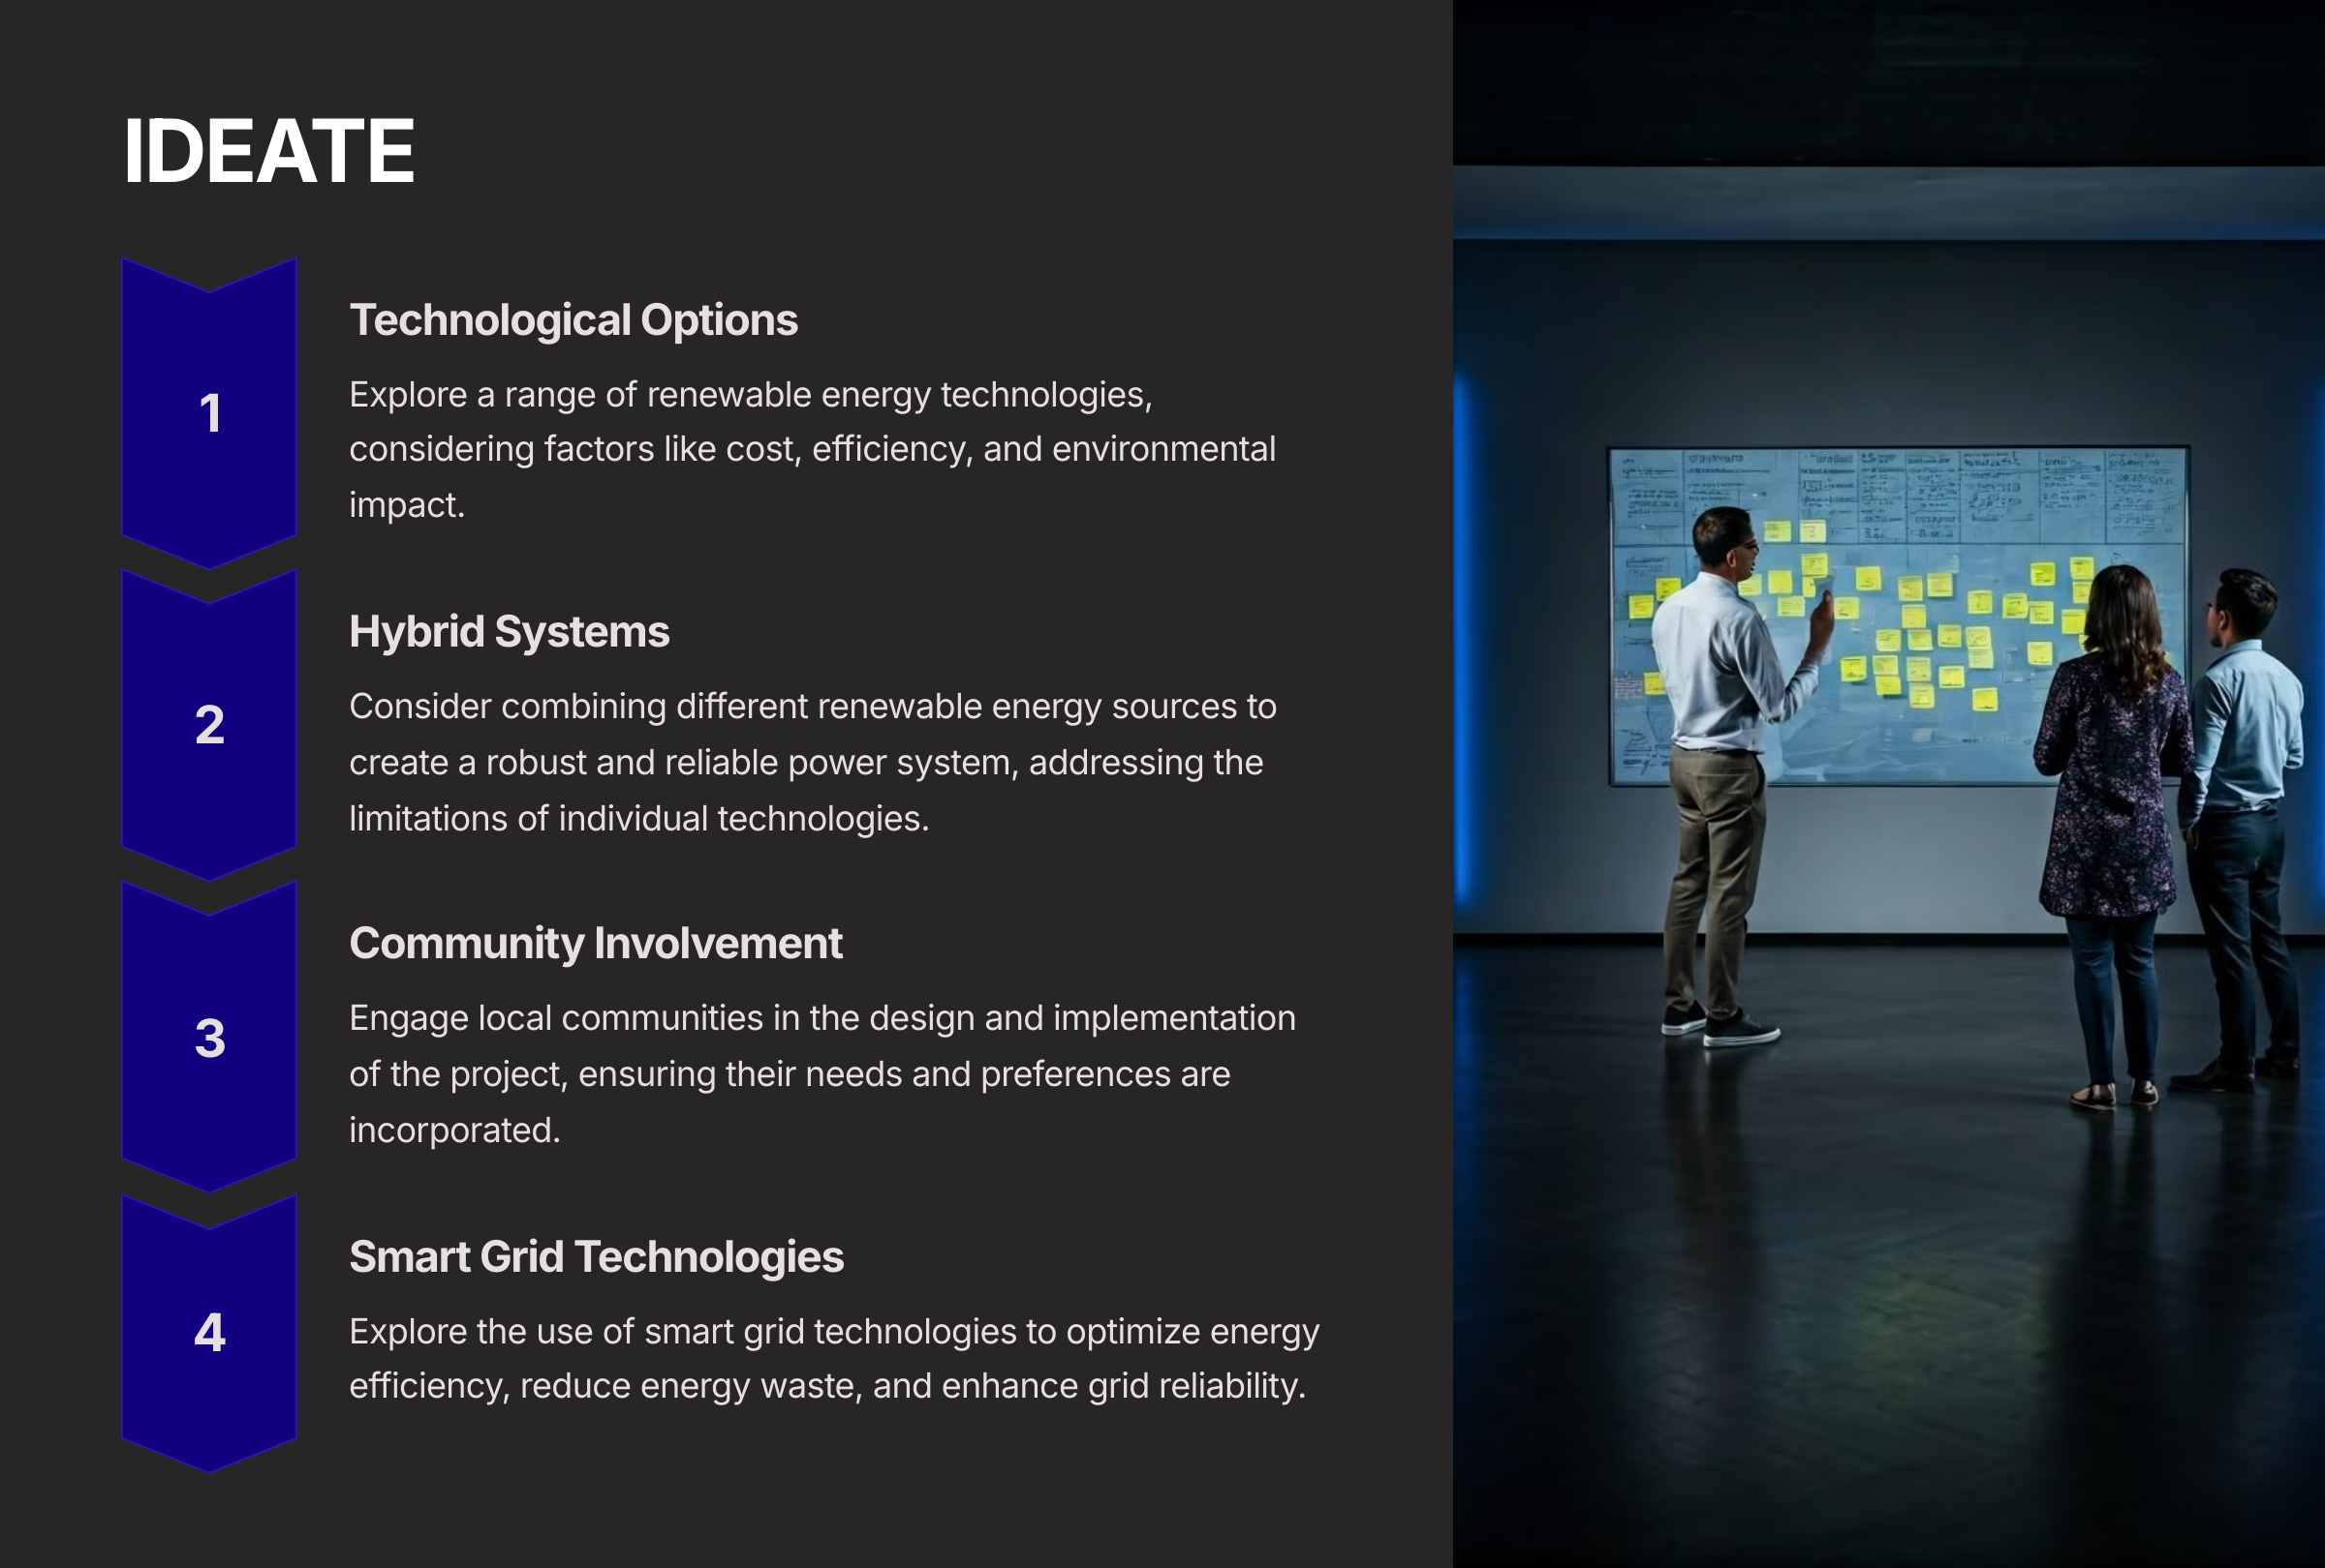

Slide 6
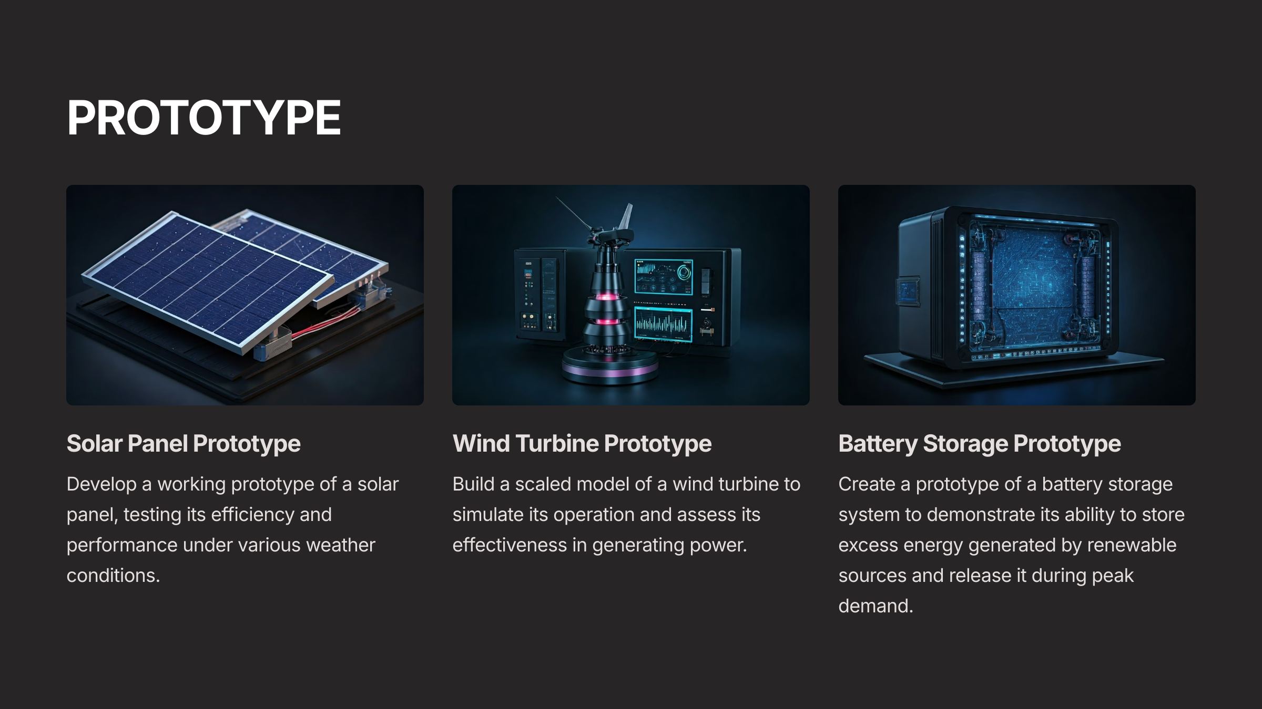

Slide 7
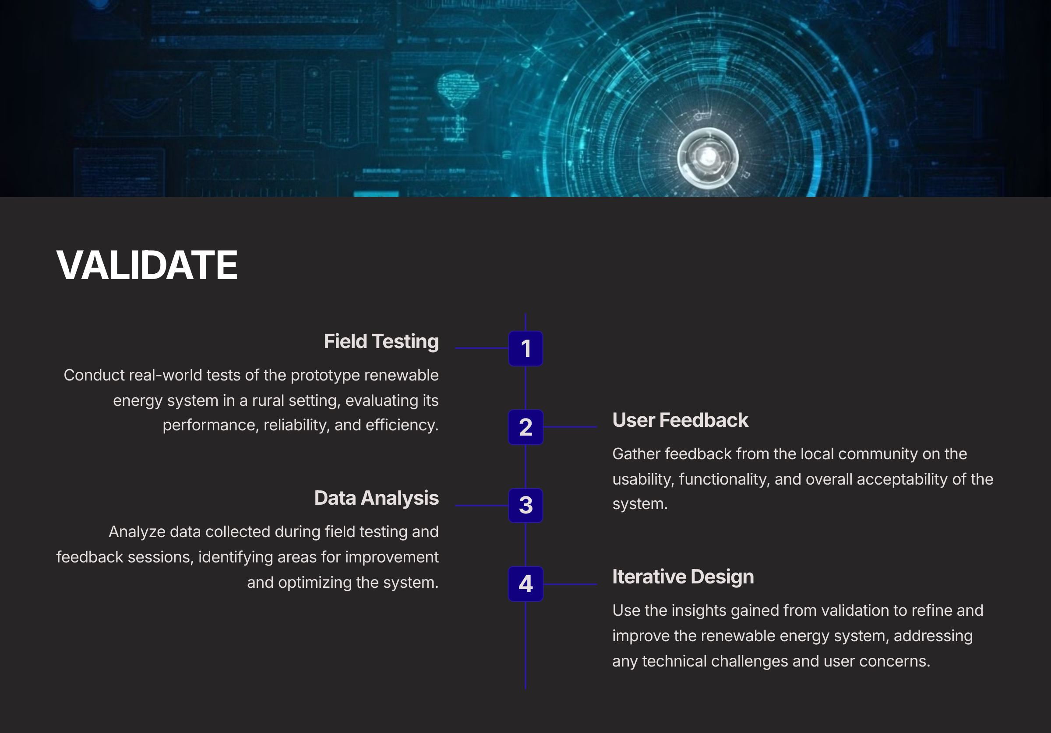

Slide 8
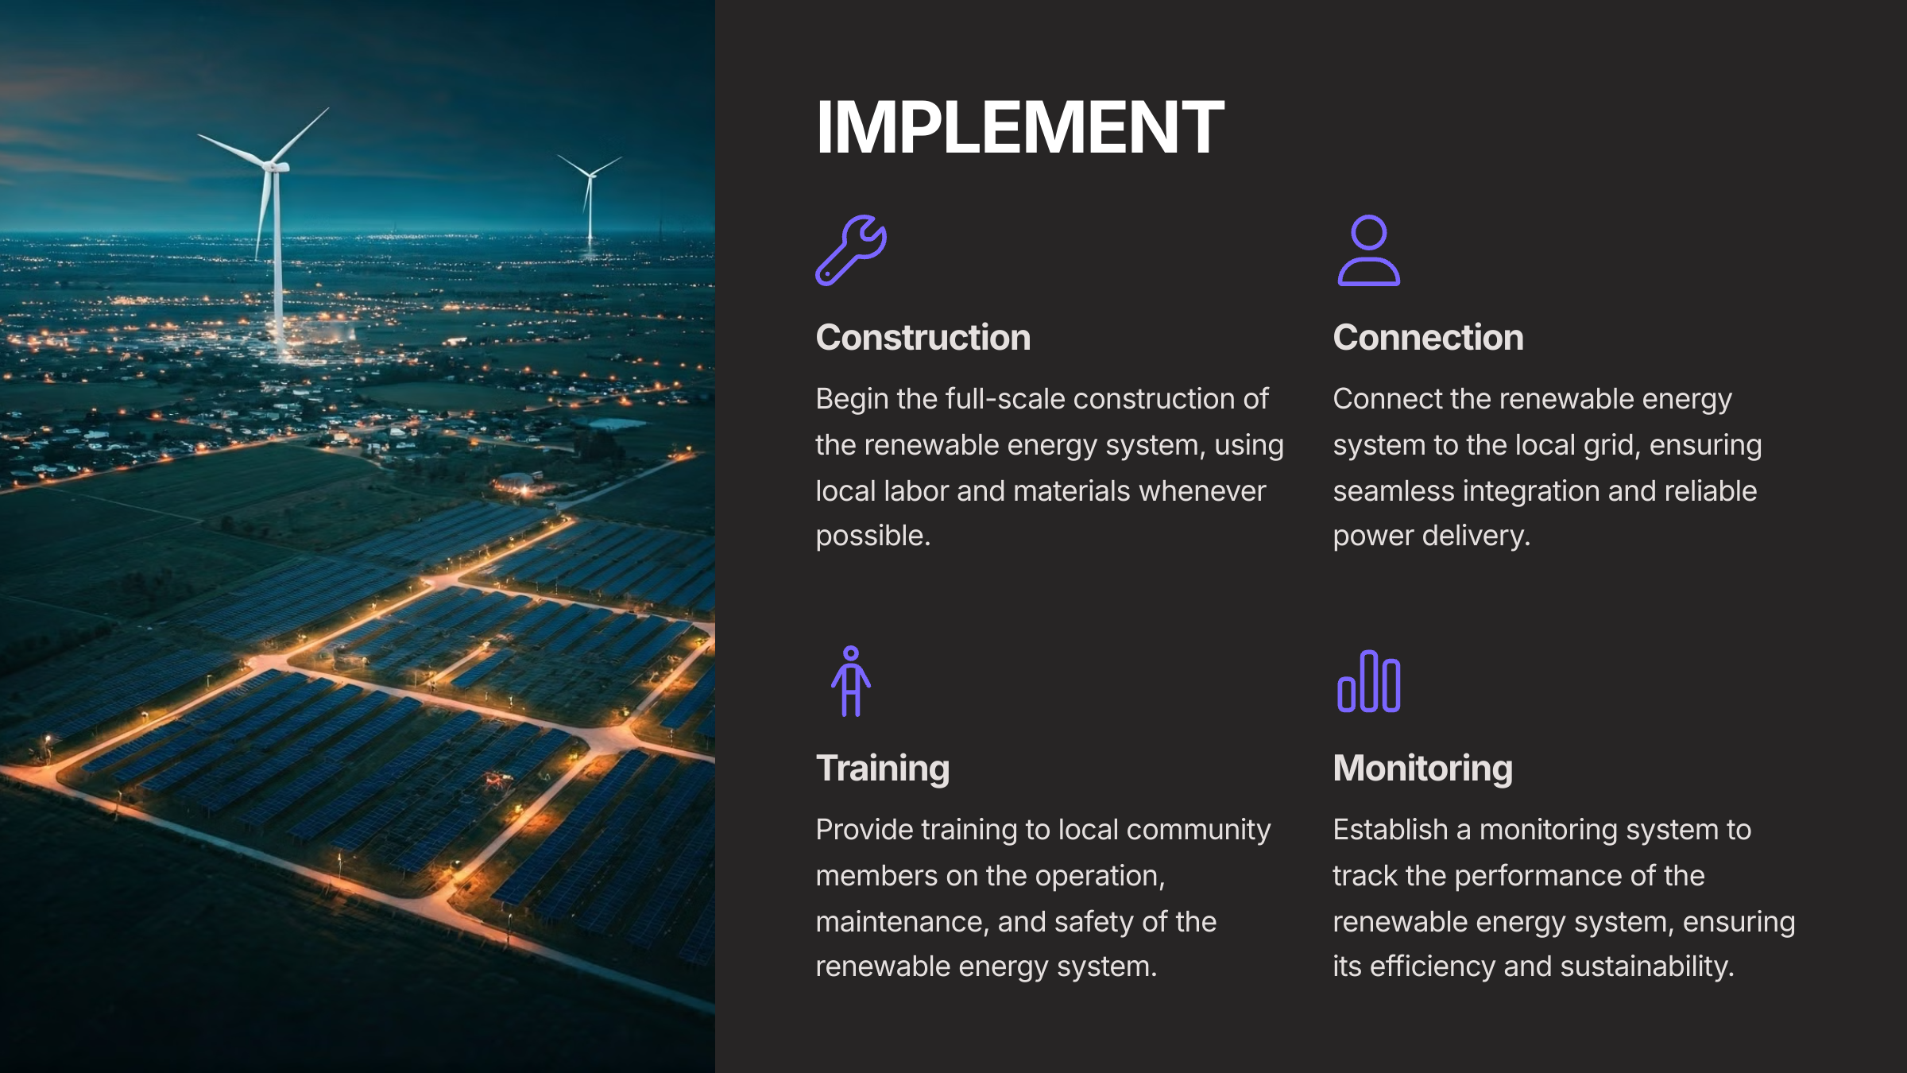

Slide 9
TEAM ENROLLMENT NUMBER
Krishnakant Mandowara : 24ME003436
SAURABH SINGH : 24EC003284
Shreya Sharma : 24CS003445
Poorva Chauhan : 24CS003448

